Slide 1
SWAMI CHINMAYANANDA AND RELIGION
PHI 2014/0472008b

Slide 2
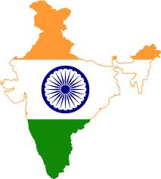
ATHENS INSTITUTE OF RESEARCH AND EDUCATION
9TH ANNUAL INTERNATIONAL CONFERENCE ON PHILOSOPHY, 26-29 MAY 2014, ATHENS, GREECE
RESEARCH PAPER
THEME :- PHILOSOPHY OF RELIGION
SUB-THEME
H.H. SWAMI CHINMAYANANDA AND RELIGION
BY
DR. VASUDHA VINOD DEO
ASSOCIATE PROFESSOR
GOVT. COLLEGE OF EDUCATION AKOLA
AFFILIATED TO
SANT GADGEBABA AMARAVATI UNIVERSITY
AMARAVATI
INDIA

Slide 3
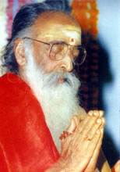
SWAMI CHINMAYANANDA AND RELIGION
Presented By
DR. VASUDHA V. DEO
ASSOCIATE PROFESSOR
SANT GADGEBABA AMARAVATI UNIVERSITY AMARAVATI
INDIA

Slide 4
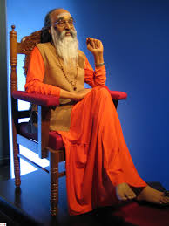
SWAMI CHINMAYANANDA
The features of his personality.
Outstanding theologian
A staunch propagator of the path of knowledge
Great scholar and sage of vedanta of modern times
Founder of “CHINMAYA MISSION” spiritual organization
Discipline, nationalism and spiritual eminence
Idol for all the devotees and followers

Slide 5
Why Swami Chinmayananda Took Up The Task Of Propagating Religion
When any generation feels emotionally insecure,
or nurtures hatred for what is the best in its culture, the only way is to remove that unnecessary sense of insecurity from the mind of the common man; only then the resurrection is possible – that was his opinion.

Slide 6
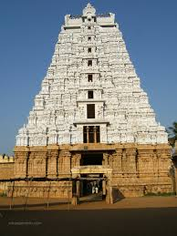
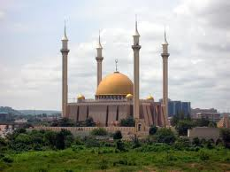
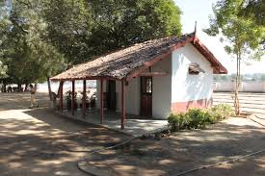
Narrower meaning of religion
Temples?
Mosques?
Religious Organizations?
Missions?
Mathas?
Schools?
Not Acceptable

Slide 7
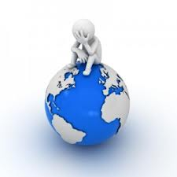
Modern man is somewhat scared of scientific and technological revolution
He is also surrounded by political, social, and natural calamities
He is living in a continuous stressful condition.
We have achieved a lot materialistically, but our lives are full of sorrow and suffering.
Even after so many scientific discoveries and revolutions

Slide 8
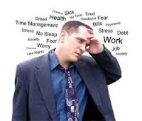
Modern man has fear of
*Modern time,
* Natural calamities,
Discoveries in science & technology.
Entire generation is growing under stress.

Slide 9
In this situation, he needs to be guided on how to activate fundamental spiritual truth.

Slide 10
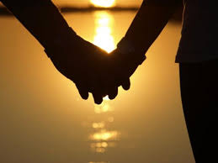
What is religion
Two important limbs
Philosophy Ritualistic Injunction
A philosophy reinforces the external practice of rituals and give them the purpose and goal for realization.

Slide 11
Religion and culture
What is Culture?
When a set of people live for a long period of time in a particular geographical area, respecting certain philosophical values and virtues of life, there emanates a fragrance which is called their cultureS

Slide 12
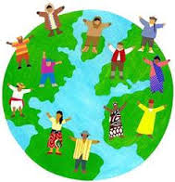
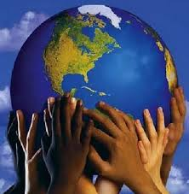
Religion and culture
Culture
Group Of People Must Exist
They Must Live Together
Live for long Period
They Respect Certain Value Of Life

Slide 13
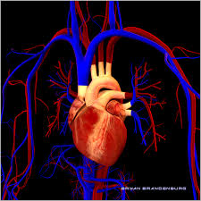
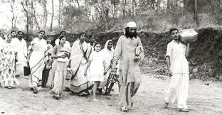
Religion and culture
“Cultural ideas in circulation are a religion and from time a religion needs change. They must put on fresh robes and re-appear on the stage of life to serve mankind.

Slide 14
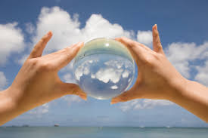
“We need a fundamental change of attitude. We need to understand that an old vision may not suit for modern time. We must adapt the vision to the new requirements of modern life.
Religion has continually changed. It should always embrace the new dimensions and demands of society.

Slide 15
Science of life and way of life
To live life by all means, with all confidence is real religion.
Religion
Science of re-evaluation of life is religion
Religion is the able science for self-perfection.
A treatment for lack of peace in life is religion

Slide 16
Perfect technique for perfect living
Gaining better mastery over oneself.
Religion
Religion is connected to man’s breathing.
Special right of man

Slide 17
Objective of life and its nature is the foundation of religion
Gives strength to face life with vigor, to one who has faith in it
Religion
Our true nature is that of pure knowledge and ultimate joy.

Slide 18
Rights and duties is religion
Religion should be built on duty on
responsibility, not on the right.
Social Meaning of Religion
Religion should consider self-duty and self-responsibility.
Duty encourages the attitude of giving.

Slide 19
Religion is English translation of word “Dharma”.
True meaning of Religion
“Dharma” is a
Sanskrit word.
The closest expression for word Dharma is Law of Being.

Slide 20
Integral attribute of fire is to burn, so that is fire’s “Dharma”.

Slide 21
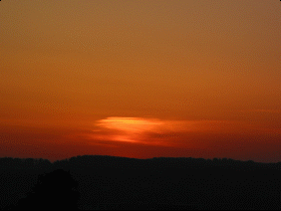
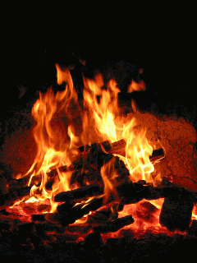
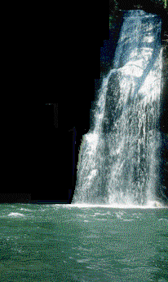
Without which a thing cannot sustain its own independent existence.= Dharma

Slide 22
What about man?

Slide 23
what is exactly man’s “Dharma”?
∙Colour of skin?
∙ Endless variety of various emotions and thoughts?
∙ Condition ?
∙ Ability of one’s nature?
∙ Body?
∙ mind?
∙ intellect ?
∙ Ego?

Slide 24
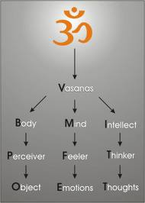
What is the “Dharma” of man?
A bundle of desires with which a person takes birth in his/her present life, is his/her “Dharma”

Slide 25
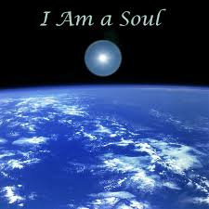
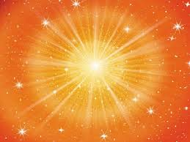
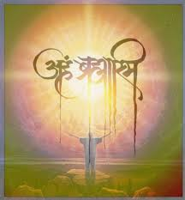
So the integral or inseparable “Dharma” of man is the divine spark of fire or Eternal “Paramatma.”

Slide 26
Everyone should act in accordance with his born, natural attributes, that is the way to live a peaceful, happy, contented life. This is ‘Swadharma’ which is integral attribute

Slide 27
Integral attribute is “Swadharma”
To behave or act against the rooted desire, is “Paradharma”(the attribute of the other). (“Dharma” and “Paradharma” - )Religion and the Religion of others

Slide 28
Values mean “Dharma”
Ready to face problems -- is “Dharma”
Completeness of morality is “Dharma”.
“Dharma” (Religion)
The eternal duties of every man is “Dharma”.
To Reach the highest level in the process of development -

Slide 29
Who is responsible for the creation of this whole universe?
Global Meaning of Religion Dharma
What is my relationship with this world?
Who created this world?

Slide 30
How and why have I come here?
Global Meaning of Religion Dharma
Who has created me?
How can I be happy?
When we apply this pure philosophy in a social situation, that becomes “Dharma” and when we practice it in our lives, religious norms are formed.

Slide 31
Today, we have accepted the notion of global village, of globalization, but have we been able to wipe out the narrow-mindedness among the people, to make it sublime and extensive?

Slide 32
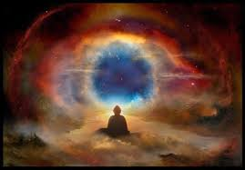
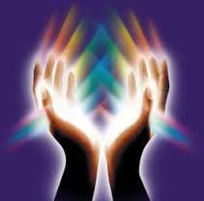
Religion gives us the feeling of co-existence.
we develop a soul-searching spiritual approach of a very high level. At that level, there is no feeling of differentiation, and the concept of “Divinity in all” takes root.
This is the feeling of global harmony. Foundation of global harmony is religion.

Slide 33
My Religious Leader
Society Started Dividing
My Religious Deeds
My Sacred Scripture

Slide 34
The purpose of religion is to eliminate ignorance through spiritual practices, until the devotee comes to gain the light of wisdom.

Slide 35
Religion and Personality Development
“Dharma” or religion helps man in developing his personality and enjoying life in a better way.

Slide 36
There is a lot of difference in the idealistic “Me”
And this difference is the measure to measure the degradation of man from the point of perfection
And the “Me”in reality,

Slide 37
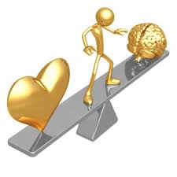
On intellectual level, we want to be ethical, good, strong and disciplined. This is an ideal picture we have about us, before our eyes.
But on emotional level, our lust, greed, likes and dis-likes, anger and hatred, love, desire, and wishes show us hopes and disappoint us.

Slide 38
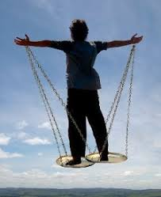
Till such time a person is not aware of the two
personalities within himself, no “Dharma” is of use to him.

Slide 39
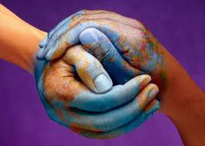
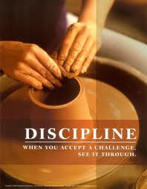
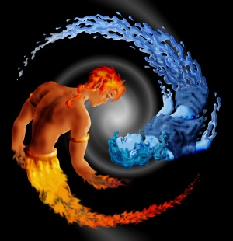
Low-graded personality is in harmony with the intellect of a man, it becomes disciplined
When low-graded personality comes under the rule of high-level personality, man starts following the “Dharma”

Slide 40
Whenever we experience low-graded feelings under the influence of divinity, the devilish tendencies in us change and this divinity becomes our friend. Here, man truly discovers his real “Dharma”

Slide 41
Provides man with highest ideals
Broader vision
Religion “Dharma”
Guide and inspire an individual working
Quality of actions
Learn to draw inspiration from our work itself
The secret of success

Slide 42
“Dharma” (Translated as ) “Religion”
Law of Being is Dharma
Without which a thing cannot sustain its own independent existence.
So the integral or inseparable Dharma of man is the divine spark of fire or Eternal “Paramatma”.
When we apply this pure philosophy in a social situation, that becomes “Dharma”
Cultural ideas in circulation is religion
Philosophy ritualistic injunction
Religion has continually changed, it should always embrace the new dimensions and demands of society.
When we practice it in our lives, religious norms are formed.

Slide 43
The “Upanishadic” culture is the culture of our country.
The values, the principles advocated by the “Rishis” , by the “Upanishadas”, are followed verbatim, that we call “Dharma.”
Our “Dharma” (Religion) - Hindutva
Many “Dharmas” together have become one “Dharma”, and that, collectively, is called “Hindutva”.
The word Hindu is not mentioned from caste or communal angle, but from global outlook

Slide 44
Those who respect and honor the noble and ethical values in life, demolish brutality within themselves, and try to re-establish the rule of God. All such people are Hindus.

Slide 45
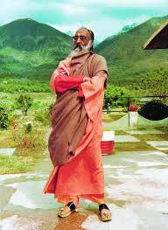
Swamiji, the Hinduness incarnate, was felicitated by the well-known American magazine “Hinduism Today” with the title “Hindu Of The Year” and the award for Hindu resurrection. This title is bestowed on a person who leaves maximum impact on Hindus all over the world. In August 1993, Swami Chinmayananda was to be honored with the “global vision 2000” award.

Slide 46
THANK YOU

